Slide 1
Honeywell Powder Amplifier
ME476C
Team 29
Presentation 3
Savana Bezdicek, Nicole Mitich, Luke Plumb, Isaac Romero, and Jacob Setzer

Slide 2
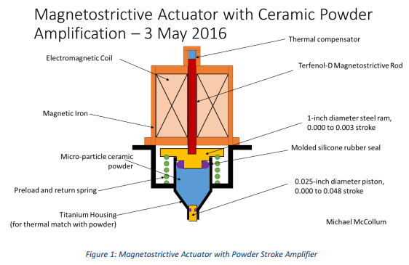
Project Description
Background:
2015-2016 Honeywell Capstone group constructed a proof-of-concept Terfenol-D actuator.
Successful, but not practical for real-world application
Goal:
Develop a practical “fluid” amplifier by matching coefficients of thermal expansion of fluid and housing.
Luke Plumb
11/30/16
Team 29: Honeywell Powder Amplifier

Slide 3
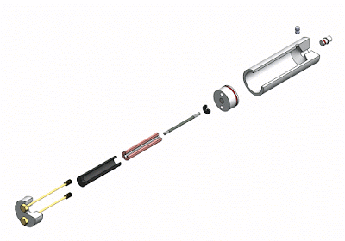
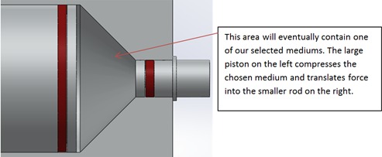
Project Description
Jacob Setzer
11/30/16
Team 29: Honeywell Powder Amplifier

Slide 4
Design Description
Originally directed to brainstorm all possible solutions to the problem - mechanical solutions, housing solutions, etc.
Upon meeting with Honeywell again, vehemently redirected to focus solely on powder applications:
Can a powder act like a fluid?
Can the powder match the coefficient of expansion of the housing?
Does hysteresis occur within the system?
Following our analytical analyses, we found that the only viable solution is a nanofluid
Nicole Mitich
11/30/16
Team 29: Honeywell Powder Amplifier

Slide 5
Design Description: Nanofluid Application
Material (nanoparticle) | Coefficient of Thermal Expansion ( ºC⁻¹) | Size Range (nm) | Density (g/cm³) | Solid Volume Fraction | Unit Price ($ / g)
Silicon Nitride | 2.8 | 10-100 | 3.2 | 0.9647 | $3.38
Aluminum Nitride | 4.6 | 10-100 | 3.26 | 0.9717 | $4.40
Synthetic Diamond | 1.1 | 10-45 | 3.05-3.3 | 0.9585 | $34.80
Silicon Nitride: highly wear resistant
low thermal conductivity
common in machine components
ceramic
cost effective
Savana Bezdicek
11/30/16
Team 29: Honeywell Powder Amplifier
Notes:
Mathematically match the CTE to the housing, calculated at 8.6 E -6
Silica Nitride, Alumina Nitride, Synthetic Diamond
Benefits of each
Introduce equation involving density to continue to use brake fluid
Further research into 3 possible materials, testing required

Slide 6
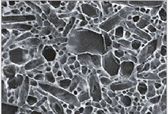
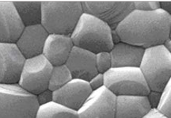
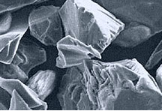
Design Requirements
Match body and powder thermal expansion
Powder acts like a semi fluid
Practical application for chosen materials
Output amplification maximized
Demonstrator retracts when force is removed
Sealing mechanisms on demonstrator
Fatigue failure minimized
Isaac Romero
11/30/16
Team 29: Honeywell Powder Amplifier

Slide 7
Schedule & Budget
Nicole Mitich
11/30/16
Team 29: Honeywell Powder Amplifier

Slide 8
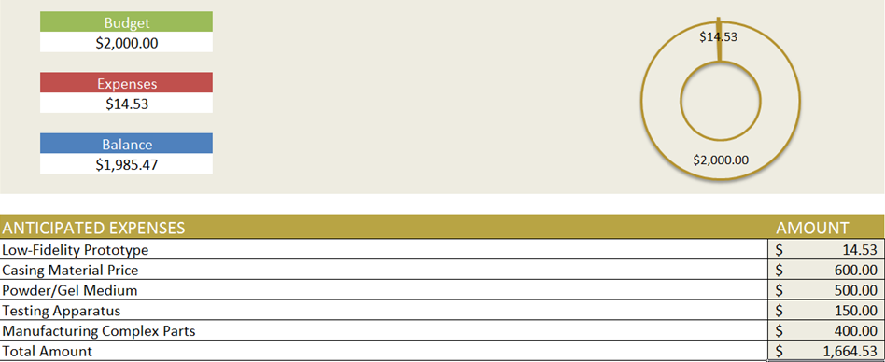
Schedule & Budget
Jacob Setzer
11/30/16
Team 29: Honeywell Powder Amplifier

